Slide 1
Wine Quality Evaluation
Yula Ko, Farzana Manjra, Natalia Gomez,
Victoria Wayda, JiaRui (Jesse) Shao
Data Diggers

Slide 2
Introduction
Determine what makes a “good” wine
We plan to determine which chemical properties make a wine 'good’ by utilizing various methods. We believe the target audience that may find this useful could be anyone else who is looking to determine the quality of wine based on these variables.
Notes:
The wine in this dataset was evaluated and their quality determined by wine professionals. We plan to analyze the data to determine which chemical properties classify a wine as 'good’ quality by utilizing various methods. We believe the target audience that may find this useful could be anyone else who is looking to determine the quality of wine based on these variables.

Slide 3
Overview
01
Intro to this data
Visualize the data
02
03
Logistic Regression
K-NN
04
05
Classification
Conclusion
06

Slide 4
INTRODUCTION
INTRODUCTION
TO THIS DATA

Slide 5
Introduction
The Variables
Fixed Acidity | Volatile Acidity | Citric Acid
Residual Sugar | Chlorides | Free Sulfur Dioxide
Total Sulfur Dioxide | Density | pH
Sulphates | Alcohol | Quality
12 Variables
1,599 Observations
Quality = Response Variable
Notes:
This data set consists of 12 variables and 1,599 observations. Quality is our response variable and we plan to determine which of these variables have a greater effect on the wine quality.

Slide 6
Data Description
Fixed Acidity - most acids in wine that do not evaporate easily
Volatile Acidity - amount of acetic acid, unpleasant taste
Citric Acid - preservative that can add a fresh taste
Residual Sugar - amount of sugar after fermentation stops
Chlorides - amount of salt
Free Sulfur Dioxide - prevents oxidation
Total Sulfur Dioxide - preservative that can affect the taste
Density - dependant on alcohol and sugar content
pH - how acidic the wine is
Sulphates - contributes to SO2 levels, preservative, fresh taste
Alcohol - the percentage of alcoholic content
Output Variable(Y-response): Quality
Notes:
I’m going to give a brief description of the data so you can see how the following attributes may have an effect on the quality of the wine. Fixed acidity refers to the acids that are present and do not evaporate easily. Volatile Acidity could indicate spoilage or mistakes in processing, such as using damaged grapes. This causes acetic acid bacteria to grow and make the wine taste unpleasant. Citric acid can add a fresh taste to the wine and it’s usually added as a preservative. Residual sugar is the amount of sugar remaining after fermentation stops. Chlorides refers to the amount of salt and free sulfur dioxide prevents oxidation, which would lead to the degredation of wine. The density of the wine is dependent on the sugar content and the pH stands for power of hydrogen, which is a measurement of the hydrogen ion concentration in the solution. Generally, solutions with a pH value less than 7 are considered acidic. Tart red wine generally has a pH of 3.1 and softer tasting red wine would have a pH of 3.8. Sulphates contribute to the SO2 levels and alcohol is the percentage of alcoholic content. Now that you have some knowledge on wine we’re going to start exploring our data.

Slide 7
VISUALIZATION
VISUALIZATION
OF THE DATASET

Slide 8
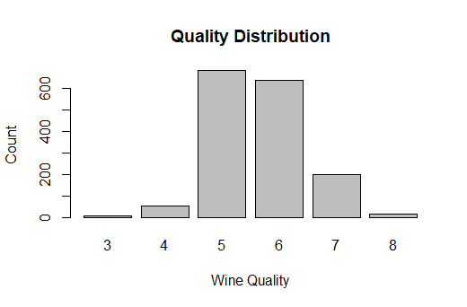
Bar Chart
Good: 855
Bad: 744
Notes:
The Quality variable (y-response) is actually not a quantitative variable but rather a qualitative (categorical) variable.
Instead of having 6 responses for quality we made it a binary response falling into the two categories, good quality or bad quality. If quality >=6 then the wine is categorized as good quality and if the quality is <6 it is considered bad quality wine. The observations appear to be fairly evenly distributed with 855 good quality and 744 bad quality wines.

Slide 9
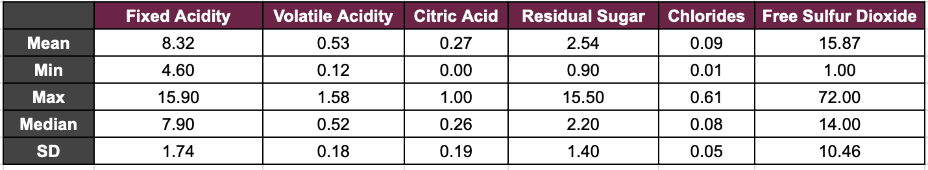
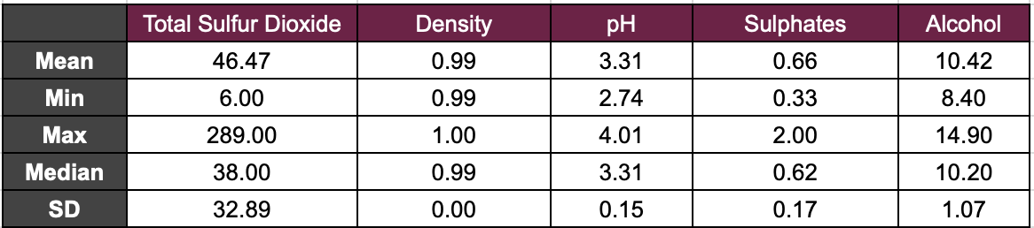
Summary Statistics
Notes:
This summary table shows statistics about all the variables that could have an effect on quality. From here we can make some interesting observations. The max value for total sulfur dioxide is 289 and the minimum value is only 6, while the median is 38. Free sulfur dioxide has a max of 72 and a minimum of 1, while the median is 14. There are clearly outliers present in these variables. The maximum and minimum pH show that there are both tart and sweet wines present, but most of the wines fall in the middle.

Slide 10
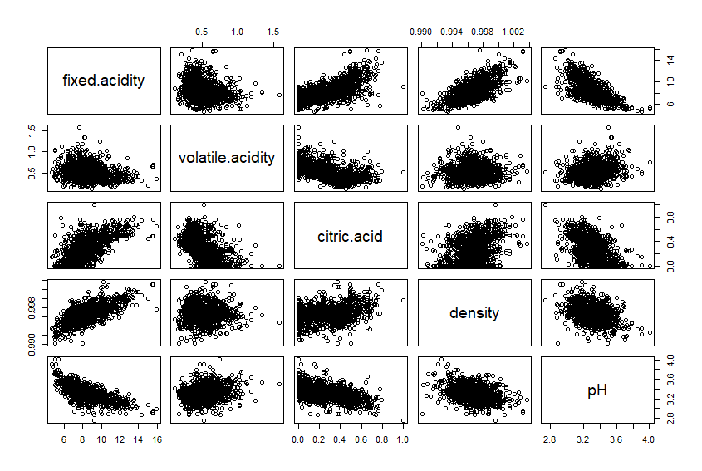
Correlation

Slide 11
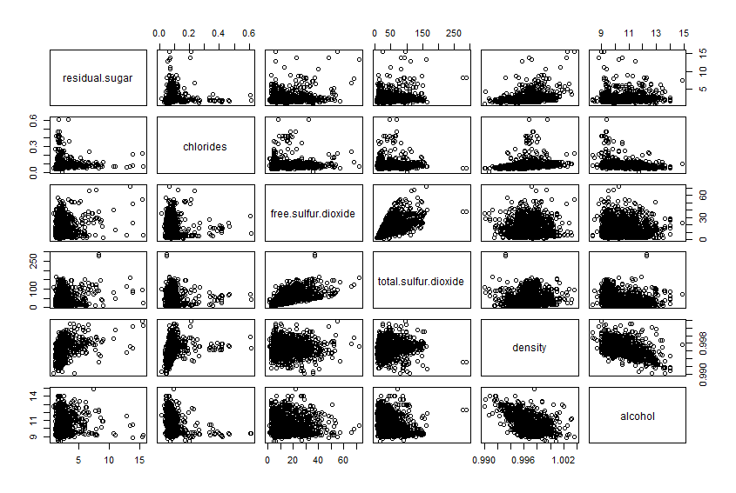
Correlation

Slide 12
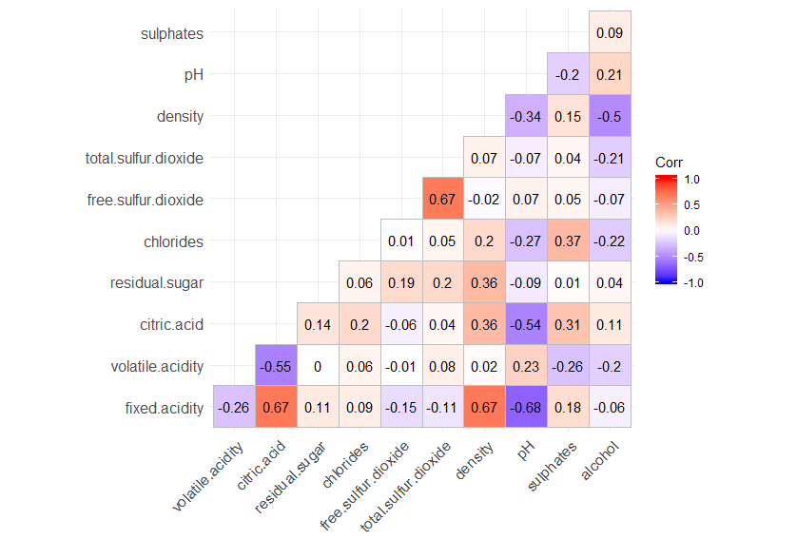
Correlation Matrix Heatmap
Red = positive correlation
Blue = negative correlation
Numbers closer to 1 or -1 mean higher correlation , 0 means no correlation
Above .70 or below -.70 means highly correlated

Slide 13
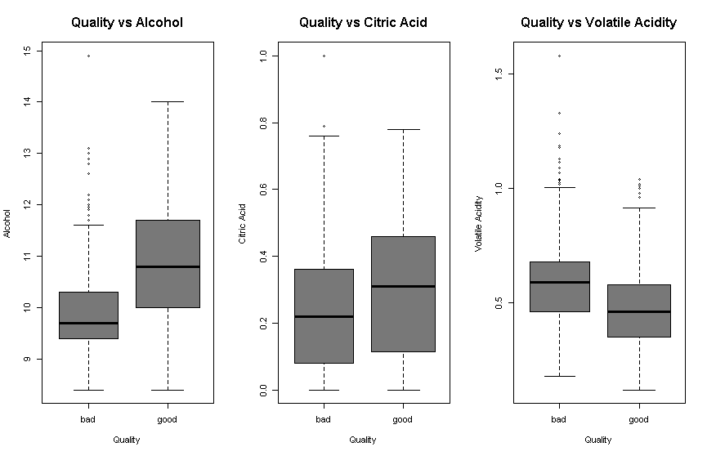
Box Plots

Slide 14
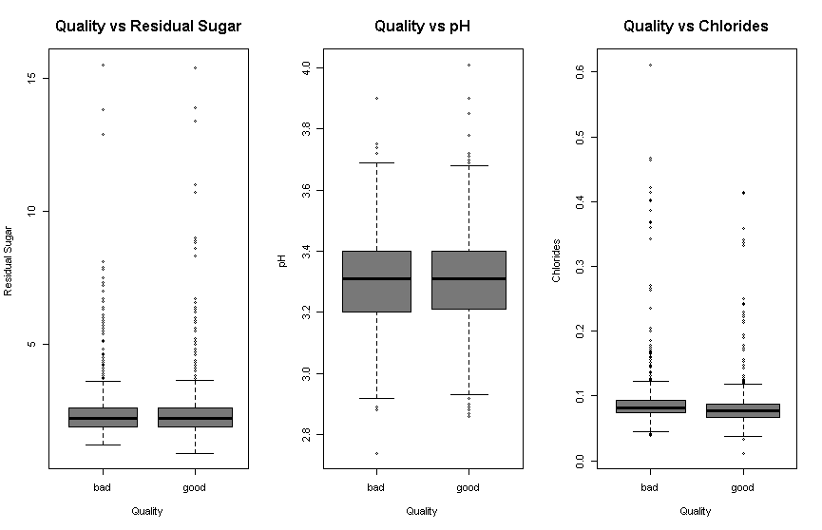
Box Plots

Slide 15
lOG
ISTIC
LOGISTIC
REGRESSION
Notes:
We are interested in predicting whether quality of wine is good , on the basis of 11 independent variables. As mentioned earlier our response is quality with 2 categories(good and bad). We can use logistic regression to estimate probability of good wine and probability of bad wine.

Slide 16
Logistic Regression
Model 1
Model 2
Model 3
Coefficients P-value
(Intercept) 0.58890
Alcohol < 2e-16 ***
Fixed Acidity 0.16736
Volatile Acidity 1.79e-11 ***
Citric Acid 0.02354 *
Residual Sugar 0.30351
Chlorides 0.01259 * Free Sulfur Dioxide 0.00698 **
Total Sulfur Dioxide 1.29e-08 ***
Density 0.53024
pH 0.59717
Sulphates 6.36e-10 ***
Coefficients P-value
(Intercept) < 2e-16 ***
Alcohol < 2e-16 ***
Volatile Acidity 1.24e-11 ***
Citric Acid 0.45448
Chlorides 0.00431 **
Free Sulfur Dioxide 0.00566 **
Total Sulfur Dioxide 6.48e-10 ***
Sulphates 2.16e-10 ***
Coefficients P-value
(Intercept) < 2e-16 ***
Alcohol < 2e-16 ***
Volatile Acidity 5.60e-15 ***
Chlorides 0.00202 **
Free Sulfur Dioxide 0.00281 **
Total Sulfur Dioxide 9.95e-11 ***
Sulphates 2.47e-10 ***
Signif. codes: 0 ‘***’ 0.001 ‘**’ 0.01 ‘*’ 0.05 ‘.’ 0.1 ‘ ’ 1
Notes:
First we fit the first model which includes all 11 independent variables with all observations and we see that not every independent variable is statistically significant.

Slide 17
Holdout Method
Model 1
Model 2
Model 3
 | True Bad | True Good
Predicted Bad | 105 | 45
Predicted Good | 27 | 143
 | True Bad | True Good
Predicted Bad | 101 | 41
Predicted Good | 31 | 147
 | True Bad | True Good
Predicted Bad | 101 | 40
Predicted Good | 31 | 148
Accuracy = 77.50%
Recall = 76.06%
Accuracy = 77.50%
Recall = 78.19%
Accuracy = 77.81%
Recall = 78.72%
Notes:
Next we evaluated the prediction accuracy of this models. We splitted the original data set into one training set and one test set. We randomly selected 80% of the observations for training and the remaining in the test set. We evaluated the performance of the model using test set and we produces a confusion matrix to determine how many observations were correctly classified.

Slide 18
10-Fold Cross-Validation
 | Accuracy
Model 1 | 74.29%
Model 2 | 74.61%
Model 3 | 74.63%
Accuracy for the third model is slightly higher. That indicates the third model is better than the first model and the second model

Slide 19
The Fitted Model
logit(π(y=1|x)= -8.14 + 0.86 alcohol - 2.9 volatile.acidity - 4.42 chlorides + 0.02 free.sulfur.dioxide - 0.02 total.sulfur.dioxide + 2.71 sulphates
Coefficient Interpretation:
0.86 tells us when increasing alcohol by one unit, the log odds of good quality is expected to increase by 0.86, with all other predictors held fixed.
good=1
bad=0
Notes:
Our final equation for LR with 6 variables and their associated coefficients

Slide 20
Odds Ratio
(Intercept) | 2.995201e+98
Alcohol | 2.361693e+00
Volatile Acidity | 5.524713e-02
Chlorides | 1.202188e-02
Free Sulfur Dioxide | 1.024149e+00
Total Sulfur Dioxide | 9.826471e-01
Sulphates | 1.496742e+01
Interpretation:
The odds of alcohol equals 2.36
It means that: holding all other independent variables at a fixed value, for a one unit increase in alcohol, the odds of wine quality good increase by a factor of 2.36;
Or we can expect to see about 136% increase in the odds of quality good.
Notes:
odds for good quality of wine are about 32.5% higher than the odds for bad quality
Volatile Acidity 0.0543 (a decrease of about 99.95%)
Quality ~ fixed acidity + alcohol + volatile acidity + citric acid + residual sugars + chlorides + free sulfur dioxide + total sulfur dioxide + density + pH +sulphates
The exponentiated coefficient is called Odds Ratio

Slide 21
K
NEAREST
NEIGHBORS
K-NN
K NEAREST NEIGHBORS

Slide 22
K-NN
K-NN
The output is qualitative
An object is classified by a majority vote of its neighbors, with the object being assigned to the class most common among its k nearest neighbors

Slide 23
K-NN
Confusion Matrix
K=1
 | True Bad | True Good
Predicted Bad | 89 | 39
Predicted Good | 58 | 141
Accuracy = 75.91%
Recall =78.33%

Slide 24
CLASSIFICATION
CLASSIFICATION
DECISION TREE & RANDOM FOREST

Slide 25
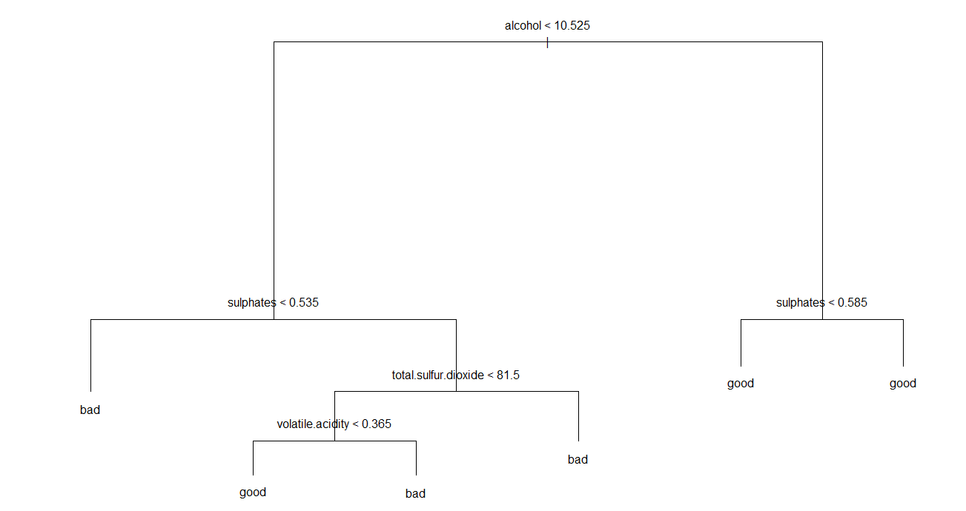
Decision Tree
Decision Tree

Slide 26
Decision Tree
Confusion Matrix
Accuracy = 70.94%
Recall = 63.83%
 | True Bad | True Good
Predicted Bad | 107 | 68
Predicted Good | 25 | 120

Slide 27

Random Forest
Random Forest
Ensemble Algorithm
Reduce chances of over-fitting
Higher model performance or accuracy
Accuracy = 83.75%

Slide 28
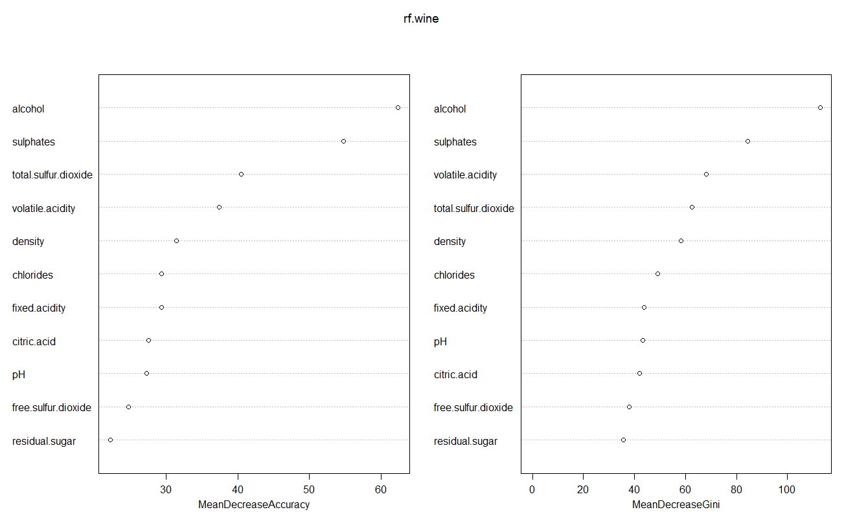
Random Forest
Variable importance

Slide 29
CONCLU
SION
CONCLUSION
HOW TO DETERMINE A GOOD WINE

Slide 30
CONCLUSION
Conclusion
Logistic Regression
1
Hold-out: 77.81%
Cross Validation: 74.63%
K-NN
75.91%
2
Classification
Decision Tree: 63.83%
Random Forest: 84.06%
3

Slide 31
Thanks for listening
Q & A

